Slide 1
Unit 02: Ethics in Business

Slide 2
Getting Started
What is ethics?
What is business?

Slide 3
Ethics is a set of moral values, It is also a system of moral principles which affect how people make decisions and lead their lives. These values are what motivate our behavior. They ground our judgments about what is good or bad, high quality or low quality, right or wrong, successful or unsuccessful, , desirable or undesirable. There are values in sports, values in art, values in social and cultural practices, values in science, values in relationships, values in economic transactions, religious values …

Slide 4
Name some of the moral values?
Moral values such as integrity, reliability, determination, loyalty, truthfulness, honesty, giving respect , probity, justice, fairness correctness, legal, transparency etc.

Slide 5
Business is the activity of buying and selling goods and services, The purchase and sale of goods in an attempt to make a profit. It ‘s any human activity directed towards producing or acquiring wealth through buying and selling of goods.

Slide 6
Match definitions with their corresponding Pictures

Slide 7
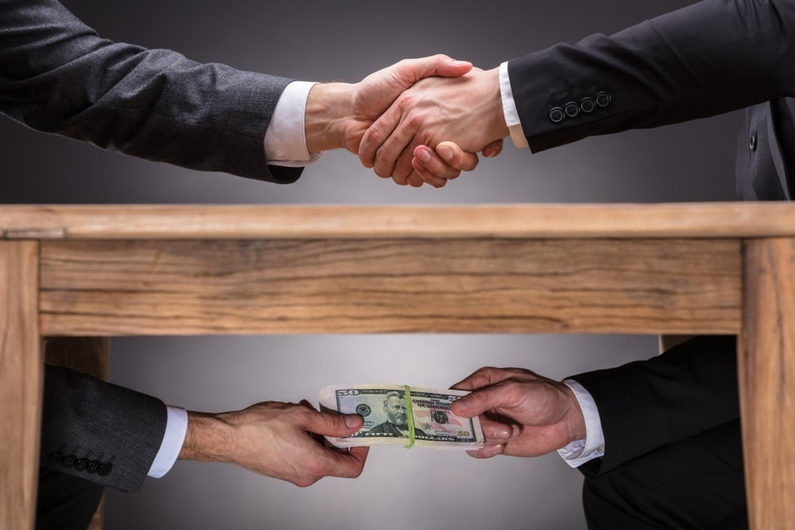
A- Bribery : offering someone money or something valuable in order to persuade him to do a favor for you.
B- Money- laundering: hiding the fact that the money was illegally obtained.
C- Tax evasion: to escape paying the full amount of tax that you should pay.

Slide 8
A- Money- laundering: hiding the fact that the money was illegally obtained.
B- Tax evasion: to escape paying the full amount of tax that you should pay.
C- Embezzlement: the theft of money or property that you officially manage.

Slide 9
A-Counterfeit: the activity of making copies and imitations of things to deceive or defraud consumers
B- Tax evasion: to escape paying the full amount of tax that you should counterfeipay.
C- Embezzlement: the theft of money or property that you officially manage.

Slide 10
A-Counterfeit: the activity of making copies and imitations of things to deceive or defraud consumers
B- Tax evasion: to escape paying the full amount of tax that you should pay.
B- Money lobbying: attempting to influence business and government leaders to create legislation or conduct an activity that will help a particular organization.

Slide 11
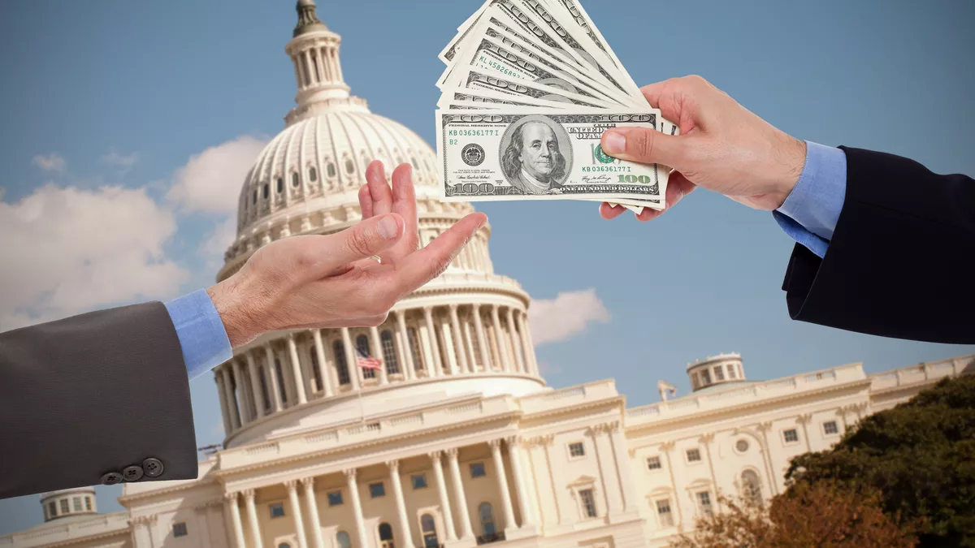
A-Counterfeit: the activity of making copies and imitations of things to deceive or defraud consumers
B- Money lobbying: attempting to influence business and government leaders to create legislation or conduct an activity that will help a particular organization.
C-False accounting: The crime of dishonestly changing figures, records etc or writing false information in a company's financial accounts in order to obtain money by deceiving people.
Congress!!

Slide 12
A-Counterfeit: the activity of making copies and imitations of things to deceive or defraud consumers
B-False accounting: The crime of dishonestly changing figures, records etc or writing false information in a company's financial accounts, deceiving people in order to obtain money by deceiving people.

Slide 13
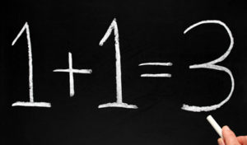
A- Nepotism: the unfair use of power in order to get jobs or other benefits for your family or friends.
B-False accounting: The crime of dishonestly changing figures, records etc or writing false information in a company's financial accounts, deceiving people in order to obtain money by deceiving people.

Slide 14
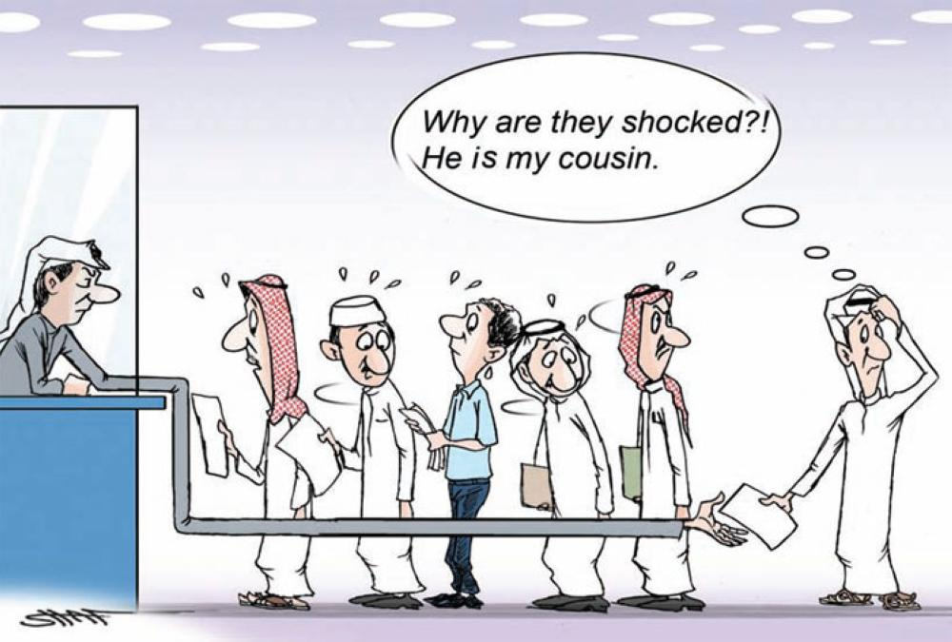
A- Nepotism: the unfair use of power in order to get jobs or other benefits for your family or friends
B- Auditing: an official examination and verification of accounts and records, especially of financial accounts. The inspection or examination of a building or other facility to evaluate or improve its appropriateness, safety, efficiency, or the like:

Slide 15
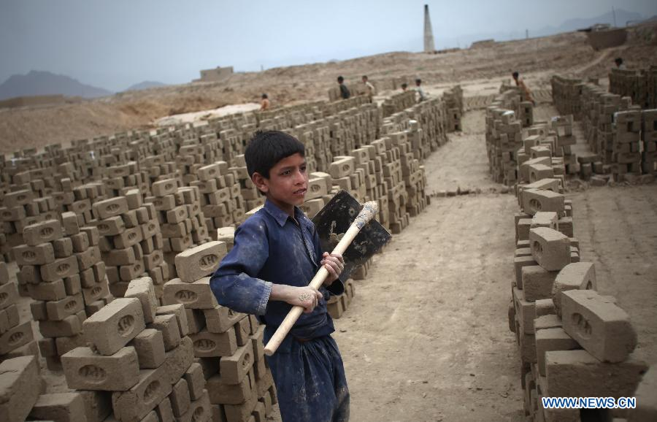
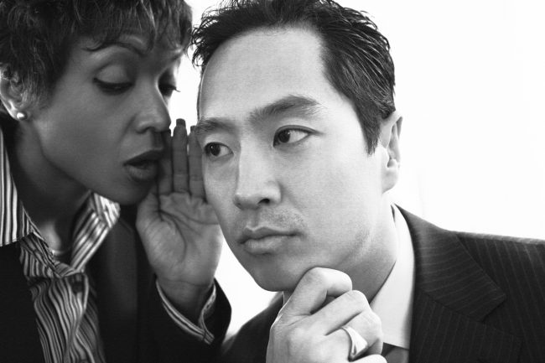
A- Whistle-blower: a person who informs on another or makes public disclosure of corruption or wrongdoing
B-Child labor: the employment of children in an industry or business
C- Smuggle: importing , exporting, or convey goods secretly or in violation of the law. It is moving (goods) illegally into or out of a country.

Slide 16
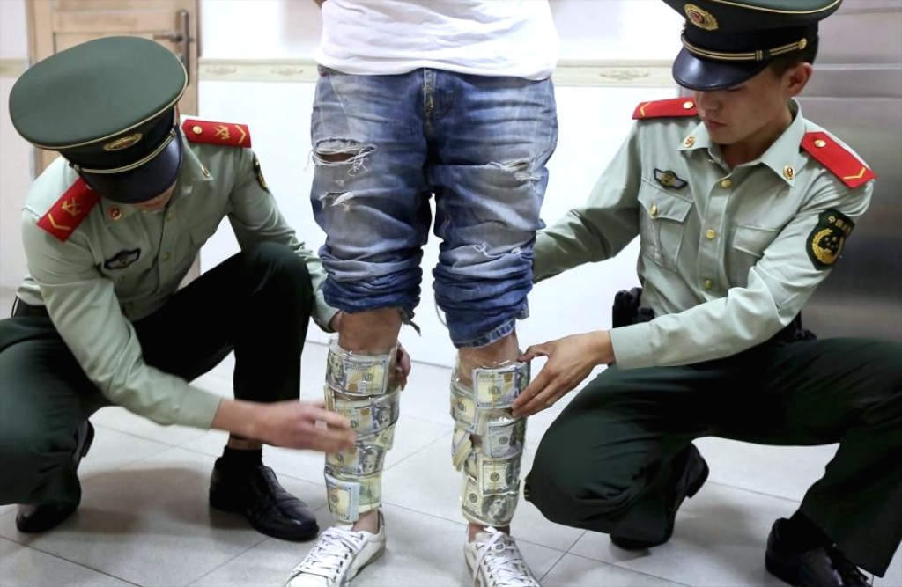
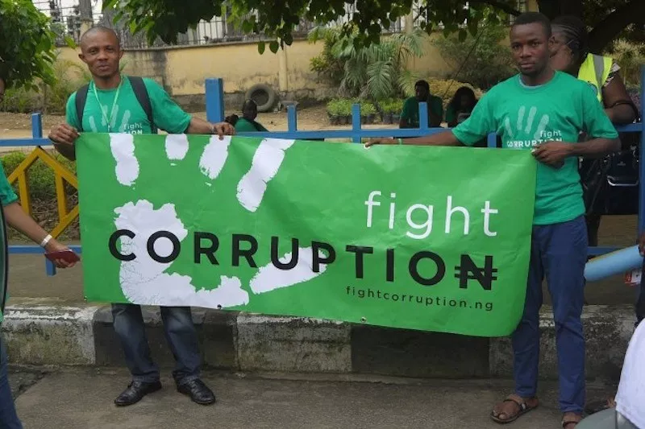
A- Militating in anti-corruption association: to have a strong influence and be a powerful or conclusive factor in preventing corruption
B- Smuggle: importing , exporting, or convey goods secretly or in violation of the law. It is moving (goods) illegally into or out of a country

Slide 17
1- Are these practices legal and morally acceptable ? Justify 2- Are they ethical or unethical practices? Justify 3- Classify these practices in the right column ( ethical or unethical)

Slide 18
bribery- money laundering- counterfeiting- whistle- blowing- child labour- smuggle- militating in anti-corruption association- nepotism- auditing- money lobbying- false accounting – tax evasion-embezzlement
Ethical practices | Unethical practices
whistle- blowing | bribery
militating in anti-corruption association | money laundering
auditing | counterfeiting
 | child labour
 | smuggle
 | nepotism
 | money lobbying
 | false accounting
 | tax evasion
 | embezzlement

Slide 19
International Organization for Standardization: a non-governmental organization that makes international rules about the quality of products and services  It maintains the transparency and clearness of businesses ISO provides guidance on how businesses and organizations can operate in a socially responsible way. This means acting in an ethical and transparent way that contributes to the health and welfare of society

Slide 20
Let’s hear it
1- Listen to the interview with Karim Bashir the head of the Right to Know association and answer the following questions:

Slide 21
A- What is the Right to Know association? B- What is its chief purpose? C- Which association published an annual report about countries’ level of corruption ? D-Which countries have the least level of corruption? E-What advice does Mr. Bashir give? F- When will we eradicate corruption? G-Is fighting corruption is the affair of the government only? justify

Slide 22
Around the Text:
Grammar Explorer 01

Slide 23
1- We will fight corruption providing (that) we act now 2- The chances of eradicating corruption will increase as long as all countries are committed to fighting it
A- Can providing that and as long as be replaced by:
a- even though? b- only if ? c- because?
B- Do providing that and as long as express:
a- concession? b- time ? c- condition ?
C- Which tenses are used in each clause? Which conditional type is it similar to?

Slide 24
Grammar Explorer 01 Expressing condition
Main clause/future+ providing( that )/ as long as + Subordinate clause/Present
Provided (that) / so long as

